Slide 1


Visvesvaraya Technological University
JnanaSangama, Belagavi
Bheemanna Khandre Institute of Technology, Bhalki
Department of CSE(Artificial Intelligence and Machine Learning)
“Presentation on College books issued database Mini Project”
Presentation by :
Rakshita Hosalli
Shruti Yekkele
Suraksha Biradar
Vaishali Lohar
USN:
3RB21AI036
3RB21AI045
3RB21AI052
3RB21AI054
Under The Guidance Of
Prof. Md Rafeeq
Prof. Mahesh Kanjikar
Department of CSE(AI&ML)

Slide 2
CONTENTS:
About Project
Objective
System Analysis
Models
System Requirements
System Design
System Testing
Scope of this project
Outputs
Conclusion

Slide 3
About Project:
This project was based on web technologies such as Html, JavaScript. MySql was used as database in this project.
This project will be helpful in registering different books easily.
Main objective of this project is to see the list of issued books and has facility of online registration of books.
This project eases modification of record that takes so long to find all data in different registers.

Slide 4
OBJECTIVE:
The objective is to build asystem that can receive input and generate automatically output in easy way and short time.
Given an opportunity to librarians to reduce mistakes that always happens in the manual method.
To store properly the library items in order to maintain their security.
To enter and preserve details of the various issues and keep a track on their returns.

Slide 5
SYSTEM ANALYSIS:
System Analysis: Is the first phase of development in case of Object Modeling too. In this phase, the developer interacts with the user of the system to find out the user requirements and analyses the system to understand the functioning.
System Design: System Design is the next development stage where the overall architecture of the desired system is decided.
Existing System: Students request for books then librarian issues them books first by checking in registers if these books are issued to someone else or not it takes so long.
Proposed System: In this system list of students with same category can be viewed. List of available books can be viewed. Fine is easily calculated by system automatically.

Slide 6
Models:
User: This contains the information of the user. This module describes user ID, name, registration no. with email ID and address can be added using this module.
Books: The information of the books available for the registration purpose along with the features. The book description with the author name and publisher name can be added using this module.
Issue Books: This contains the information of the books issued. This module describes the book & user ID with the date of issue and return date can be added using this module.
Fine Information: This contains the information of the fine charged on the user. This module consists of the book, fine & user ID with the amount charged on the book and return date can be added using this module.
Admin: This module comprises of admin login page in which user can login into the digital library by entering their user name & their password.

Slide 7
System Requirements:
Software requirements:
Operating System : Windows XP
Technology : Java 1.6
Web Technologies : Html, JavaScript
Web Server : Tomcat 5.5
Database : MySql
Hardware requirements:
Processor : Pentium Dual core 1.6
Hard Disk : 160GB
RAM : 512MB

Slide 8
SYSTEM DESIGN:
System Design is the next development stage where the overall architecture of the desired system is decided.
The system is organized as a set of sub systems interacting with each other.
While designing the system as a set of interacting subsystems, the analyst takes care of specifications as observed in system analysis as well as what is required out of the new system by the end user.

Slide 9
SYSTEM TESTING:
Unit Testing: The procedure level testing is made first. By giving improper inputs, the errors occurred are noted and eliminated. Then the web form level testing is made.
Integration Testing :Testing is done for each module. After testing all the modules, the modules are integrated and testing of the final system is done with the test data, specially designed to show that the system will operate successfully in all its aspects conditions.
Validation Testing : The final step involves Validation testing, which determines whether the software function as the user expected.
Maintenance : The objectives of this maintenance work are to make sure that the system gets into work all time without any bug.

Slide 10
Software Testing : Software testing can also be stated as the process of validating and verifying that a software program/application/product:
Meets the business and technical requirements that guided its design and development.
Works as expected.
Can be implemented with the same characteristics.
Specification-based testing: Specification-based testing aims to test the functionality of software according to the applicable requirements.

Slide 11
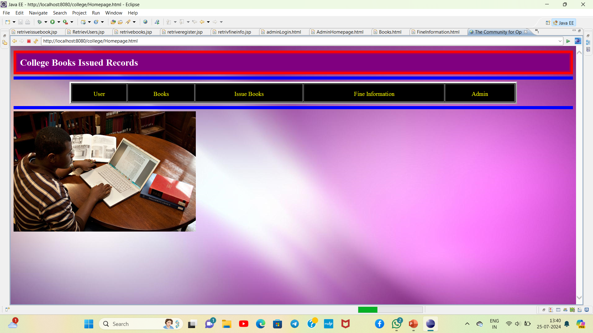
OUTPUT:

Slide 12
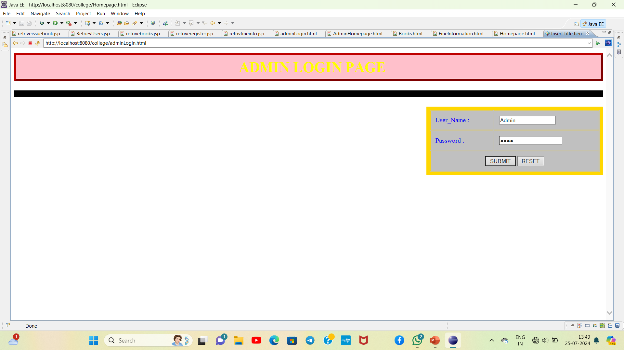

Slide 13
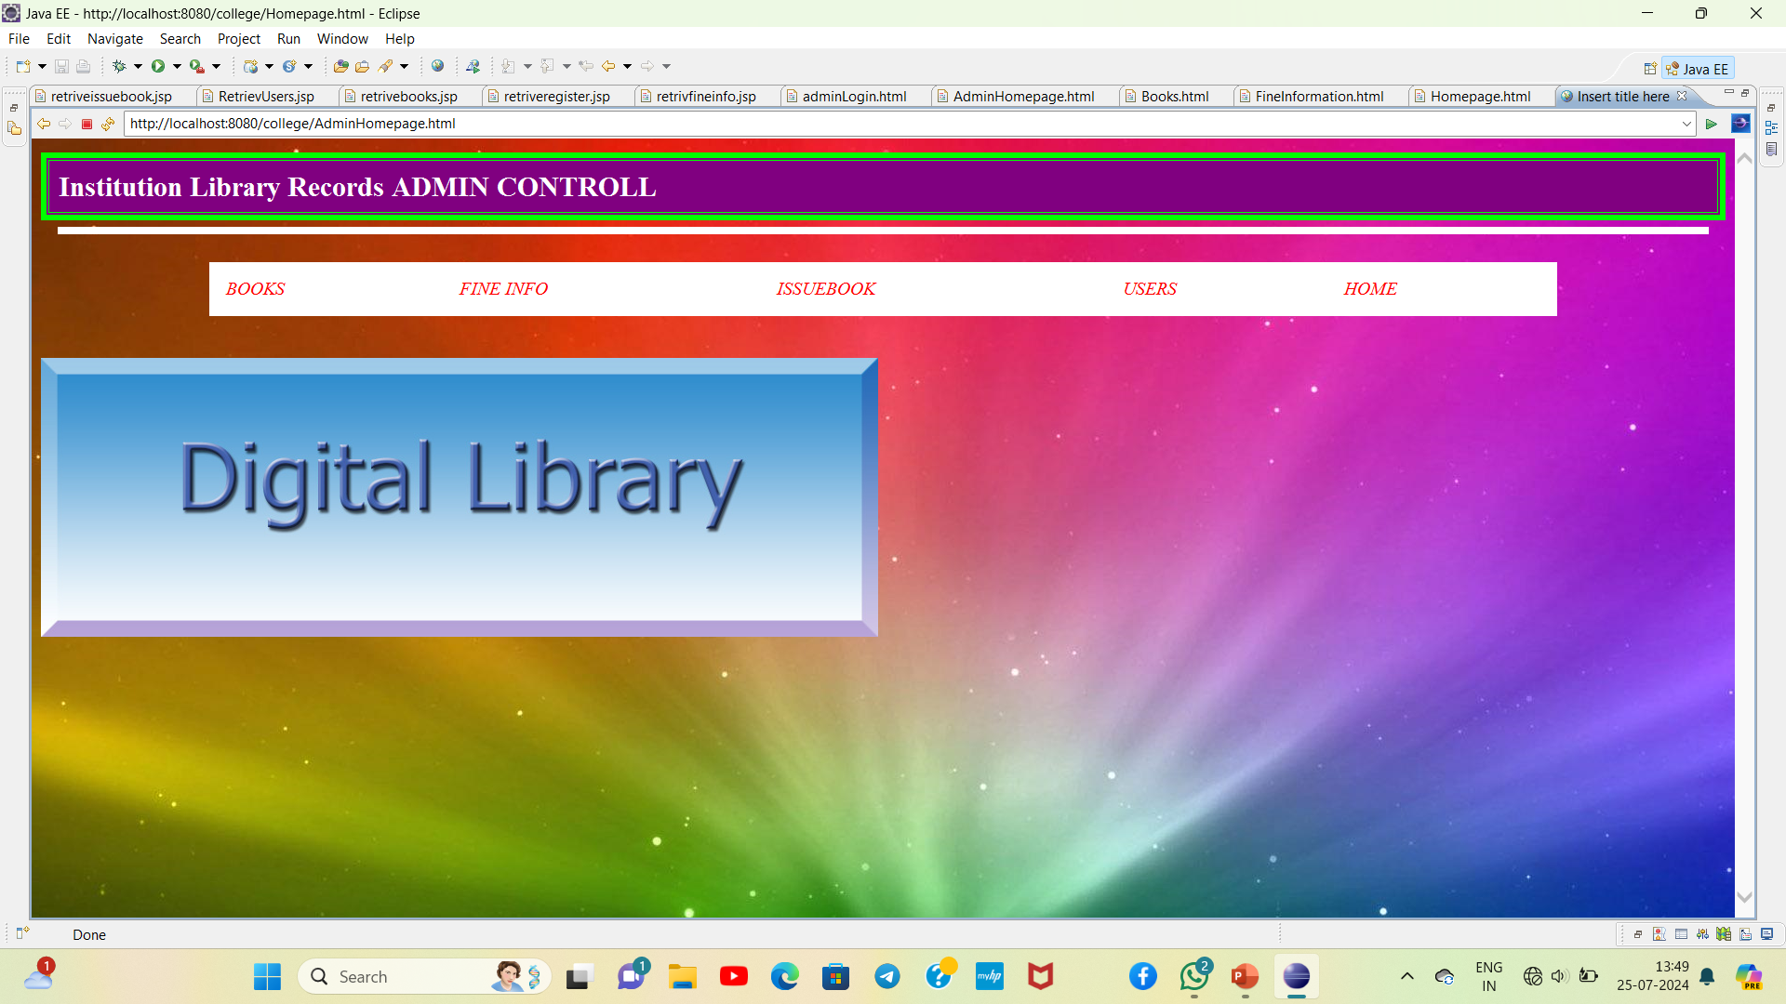

Slide 14
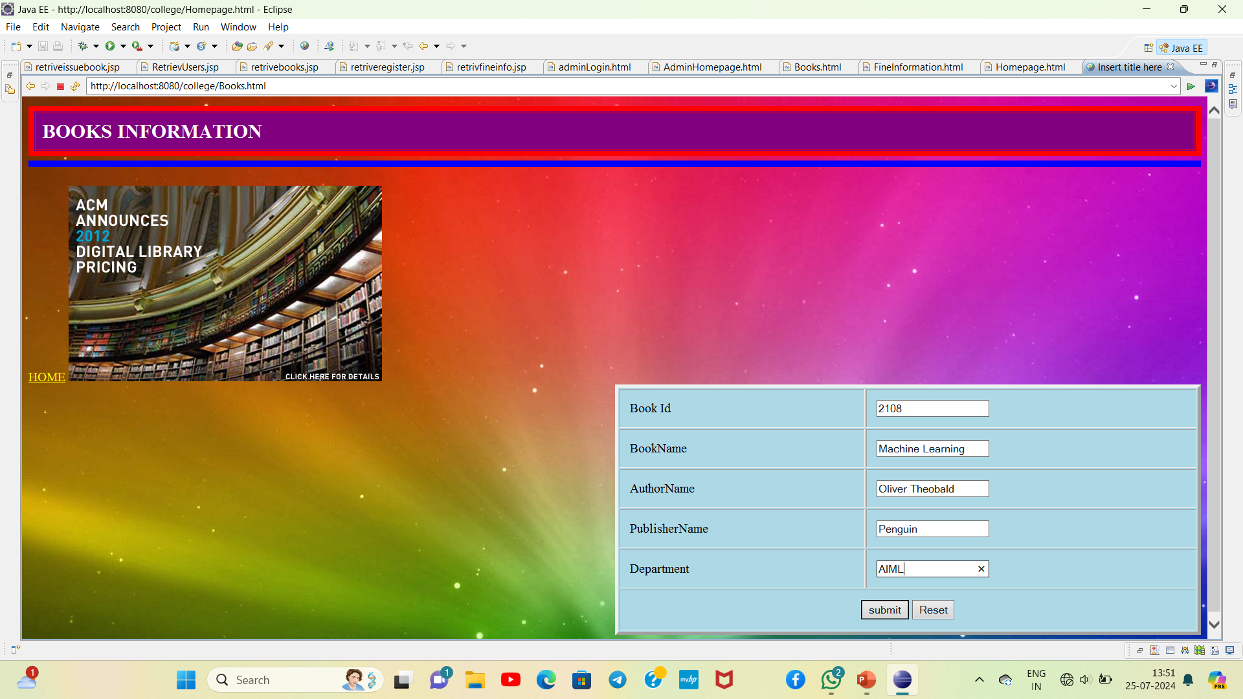

Slide 15
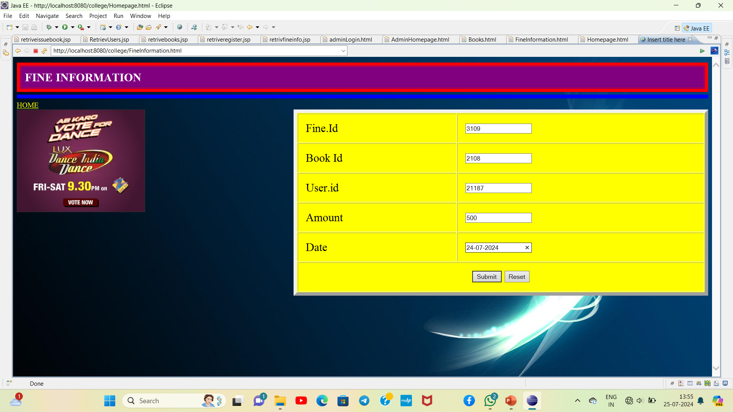

Slide 16
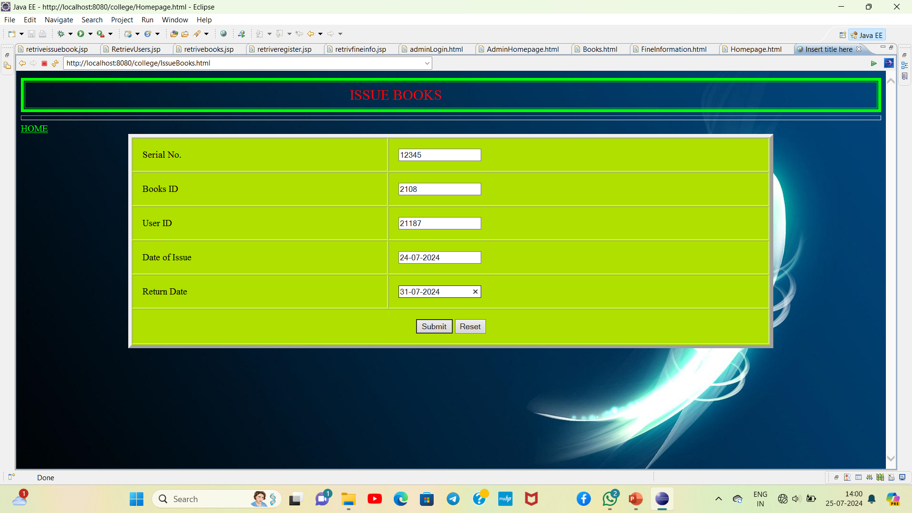

Slide 17
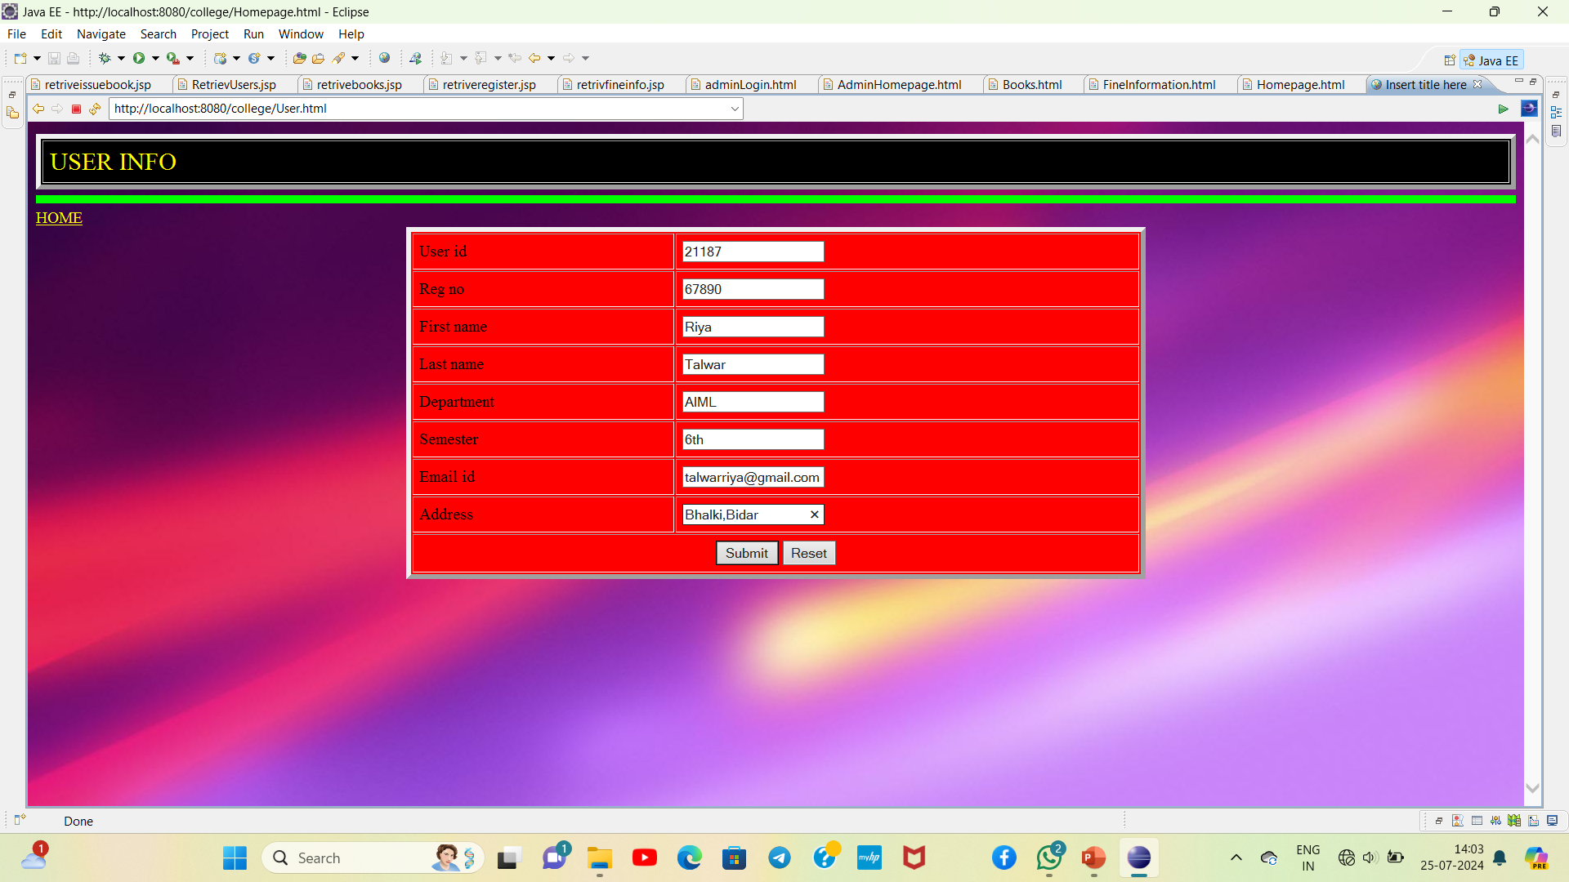

Slide 18
SCOPE OF THIS PROJECT:
Detail of each student/member is stored in database.
Large number of volume of books are easily maintained.
List of available books can be viewed.
Can see the list of issued books.
List of books not returned on time by entering their id or name of book.
Fine is easily calculated by system automatically.
List of books not returned on time by entering their id or name of book.
Librarians has password and login detail of database so it is secure process.

Slide 19
CONCLUSION:
Our web-based application “College books issued database” which provides complete information about users like students, admin and lecturer.
We will add more content on them in future . In our web-based application right now , only books and users with their information available but in future we will add online lectures, links etc.

Slide 20
THANK YOU

